Slide 1
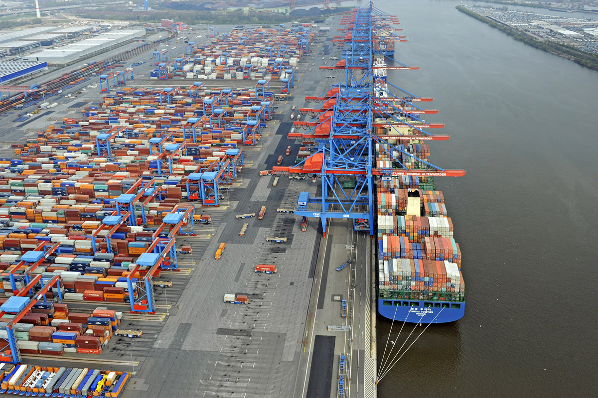
Project Containing
Groep 8
Matthijs Hovestad
Moreno Bralts
Thom Wouda
Jeroen van der Meulen
Bram Honingh

Slide 2
Index
Tasks
Bram into the team
Ruben leaving the team
Video
Questions

Slide 3
Tasks
Matthijs
Moreno
Thom
Jeroen
Bram

Slide 4
Bram into the team
From HvA to NHL
In the middle of the project
Experience

Slide 5
Ruben leaving the team
Unexpected
Code we didn’t understand

Slide 6
Video
DEMO

Slide 7

Questions?

